Slide 1
ASP.NET MVC Advanced
Rajeev DL

Slide 2
Topics
Internationalization
Filters
Theme Support Using Custom View Engine
Best Practices

Slide 3
Internationalization
Process of designing a website that can be easily adapted to different locales

Slide 4
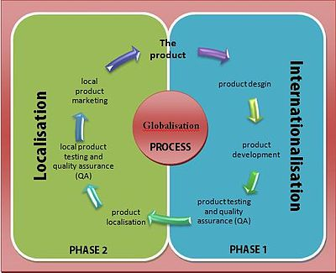
The Globalization process
Globalization (g11n) is the complete process of making your application available in multiple languages. Internationalization (i18n) is the process of designing your application so that it can be translated to different languages (so not hardcoding the text of labels and menu's into the application) making sure it can handle different currencies, time formats etc etc etc. Localization (L10n) is the process of actually translating the application into a new language.

Slide 5
Culture
The format for the culture name is "<languagecode2>-<country/regioncode2>",
<languagecode2> is the language code
<country/regioncode2> is the subculture code
Example: (http://www.basicdatepicker.com/samples/cultureinfo.aspx)
es-CL for Spanish (Chile)
en-US for English (United States)
Culture: It is a language and, optionally, a region
Neutral culture: A culture that has a specified language, but not a region. (e.g. "en", "es")
Specific culture: A culture that has a specified language and region. (e.g. "en-US", "en-GB", "es-CL")

Slide 6
Culture and UICulture
ASP.NET keeps track of two culture values, the Culture and UICulture
The Culture value determines the results of culture-dependent functions, such as the date, number, and currency formatting.
The UICulture determines which resources are to be loaded for the page by the ResourceManager.
The ResourceManager looks for culture-specific resources that is determined by CurrentUICulture
Every Thread in .NET has CurrentCulture and CurrentUICulture objects. So ASP.NET inspects these values when rendering culture-dependent functions.
Example,
CurrentCulture >> "en-US" (English, United States), DateTime.Now.ToLongDateString() >> "Saturday, January 08, 2011“
CurrentCulture >> "es-CL" (Spanish, Chile), DateTime.Now.ToLongDateString() >> "sábado, 08 de enero de 2011"

Slide 7
Why do we need a region
If your application just shows English text readable to people from these English-speaking countries, you will not need a region (US/UK English)
The problem arises when you need to deal with numbers, dates, and currencies
26-07-2011 >> Date in es-CL, Spanish (Chile)
$5.600,00 >> Currency in es-CL, Spanish (Chile)
26/07/2011 >> Date in es-MX, Spanish (Mexico)
$5,600.00 >> Currency in es-MX, Spanish (Mexico)

Slide 8
How to Support Different Languages in ASP.NET MVC
Ways to incorporate different languages and cultures in ASP.NET MVC:
By using resource strings in all our site views.
By using different set of views for every language and locale.
By mixing between 1 and 2
Which one is the best? – Matter of Convenience
Might also need to handle left-right layout
Better to mix both
Notes:
Which one is the best?
It is a matter of convenience. Some people prefer to use a single view for all languages because it is more maintainable. While others think replacing views content with code like "@Resources.Something" might clutter the views and will become unreadable. Some project requirements force developers to implement different views per language. But sometimes you have no choice where layout has to be different like right-to-left languages. Even if you set dir="rtl", this may not be enough in real applications unless the project’s UI layout is really simple. Perhaps, a mix of the two is the best. Anyway, for this example, it makes sense to use resources since we won’t have any issue with the layout for the Spanish, English, and Arabic languages that we will use.

Slide 9
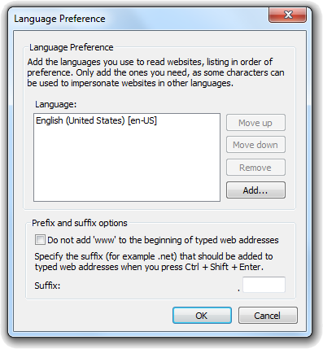
How ASP.NET guess user’s language?
On each HTTP request, there is a header field called Accept-Language which determines which languages the user’s browser supports:
Accept-Language: en-us,en;q=0.5
This means that my browser prefers English (United States), but it can accept other types of English.
The "q" parameter indicates an estimate of the user’s preference for that language. (defaults value is 1)
You can control the list of languages using your web browser.
Accept-Language: da, en-gb;q=0.8, en;q=0.7
I prefer Spanish, but will accept British English and other types of english

Slide 10
Demo
Reference: http://afana.me/post/aspnet-mvc-internationalization.aspx

Slide 11
Left-to-right or Right-to-left
HTML supports rtl languages too, so we need to make sure our main HTML tag has the appropriate direction.
<html lang="@CultureHelper.GetCurrentNeutralCulture()" dir="@(CultureHelper.IsRighToLeft() ? "rtl" : "ltr")">
We need to provide basically two sets of CSS and JS files: One for left-to-right languages and one for right-to-left languages
Install-Package Twitter.Bootstrap.RTL
Make sure you have the two files bootstrap-rtl.js and bootstrap-rtl.css
bundles.Add(new ScriptBundle("~/bundles/bootstrap-rtl").Include(
"~/Scripts/bootstrap-rtl.js",
"~/Scripts/respond.js"));
bundles.Add(new StyleBundle("~/Content/css-rtl").Include(
"~/Content/bootstrap-rtl.css",
"~/Content/site.css"));
@Scripts.Render("~/bundles/bootstrap" + (CultureHelper.IsRighToLeft() ? "-rtl" : ""))
@Styles.Render("~/Content/css" + (CultureHelper.IsRighToLeft() ? "-rtl" : ""))

Slide 12
Summary
Add a base controller from which all controllers inherit. This controller will intercept the view names returned and will adjust them depending on the current culture set.
Add a helper class that stores the list of culture names that the site will support.
Create resource files that contain translation of all string messages. (e.g. Resources.resx, Resources.es.resx, Resources.ar.resx, etc )
Update views to use localized text.
Localize javascript files.

Slide 13
Filters
simple way to inject your piece of code or logic either before or after an action is executed

Slide 14
Filters
Filters are designed to inject miscellaneous logic in to life cycle
Filters are custom classes that provide both a declarative and programmatic means to add pre-action and post action behavior to controller action methods.
Type to filter used has some expectation, on what is should be used for
In MVC5 there are 5 types of filters

Slide 15
Filter Types
Filter Type | Description | Built-in Filter | Interface
Authentication Filter | Performs authentication before executing action method. |  | IAuthenticationFilter
Authorization Filter | Performs authorization before executing action method. | [Authorize], [RequireHttps] | IAuthorizationFilter
Action Filters | Performs some operation before and after an action method executes. |  | IActionFilter
Result Filters | Performs some operation before or after the execution of view result. | [OutputCache] | IResultFilter
Exception Filters | Performs some operation if there is an unhandled exception thrown during the execution of the ASP.NET MVC pipeline. | [HandleError] | IExceptionFilter

Slide 16
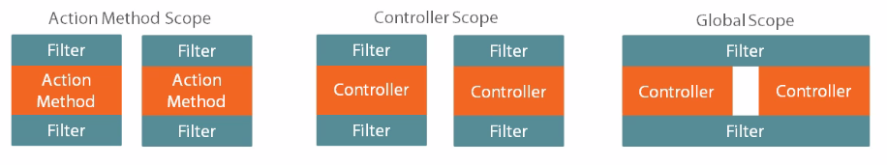
Filter Scope

Slide 17
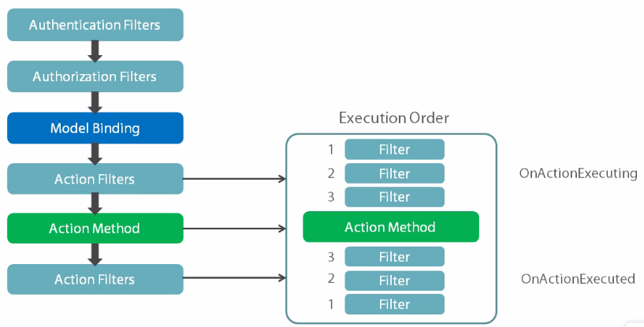
Filter Execution Process

Slide 18
Demo

Slide 19
Action Filters
an attribute that you can apply to a controller action

Slide 20
Action Filter Basics
Public class SampleFilter: FilterAttribute, IActionFilter
{
public void OnActionExecuted(ActionExecutedContext filterContext)
{
}
public void OnActionExecuting(ActionExecutingContext filterContext)
{
}
}

Slide 21
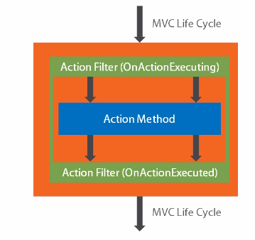
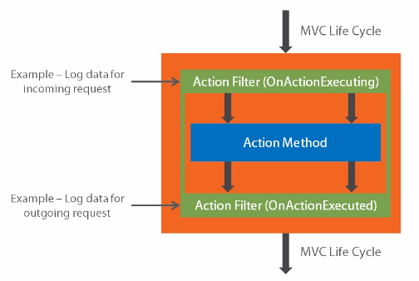
Injecting Additional Logic

Slide 22
Action Filters
Powerful component of MVC that allows you to inject additional logic into the processing pipeline
Allows to run some code which doesn’t relate with the logic
Executed before or after an action is executed
IActionFilter interface is used to create an Action Filter which provides two methods
OnActionExecuting and OnActionExecuted which will be executed before or after an action is executed respectively

Slide 23
Controller Action Filter Methods
Public class SampleController: Controller
{
public ActionResult Index()
{
return View();
}
public override void OnActionExecuting(ActionExecutingContext filerContext)
{
base.OnActionExecuting(filterContext);
}
public override void OnActionExecuted(ActionExecutedContext filterContext)
{
base.OnActionExecuted(filterContext);
}
}

Slide 24
Other Alternatives
You can use ActionFilterAttribute class, which implements both IActionFilter and IResultFilter
This class provides implementation for
OnActionExecuting
OnActionExecuted
OnResultExecuting
OnResultExecuted
You can override the ones you need.
This allows to package both action and result filters at one place

Slide 25
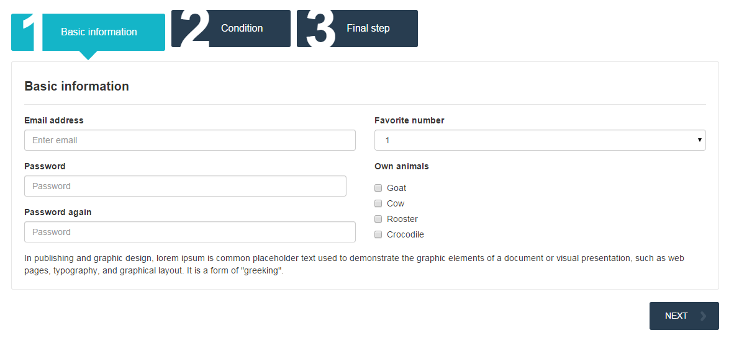
Example

Slide 26
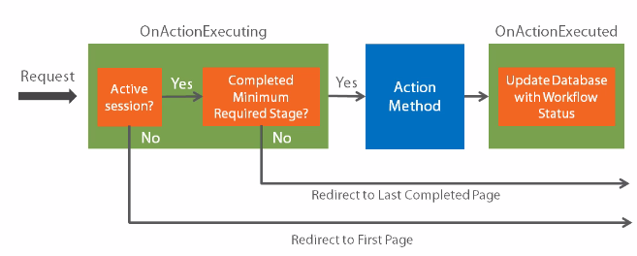
Filtering the Request

Slide 27
Authentication Filters
Verifies who you are

Slide 28
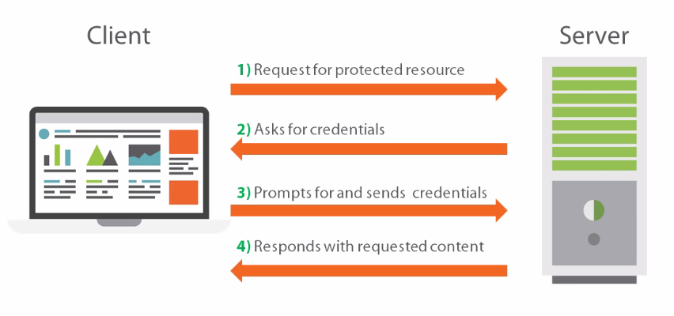
Basic HTTP Authentication

Slide 29
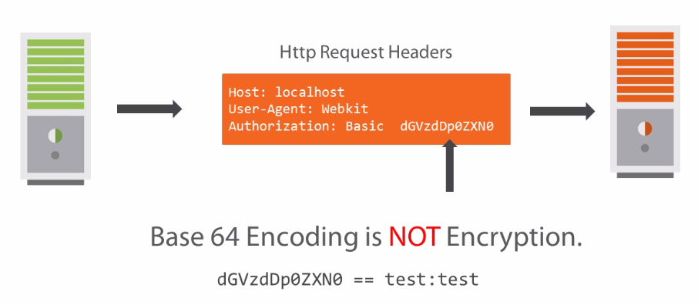
Basic Authentication Security Considerations

Slide 30
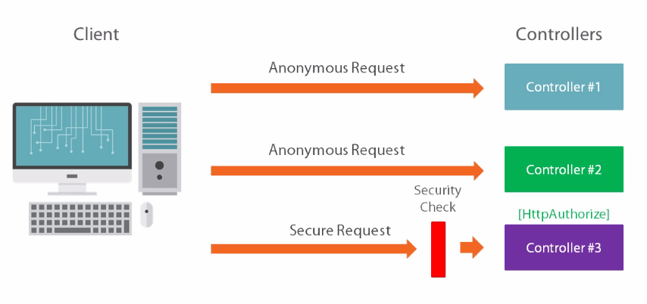
Controlling the Scope of Security

Slide 31
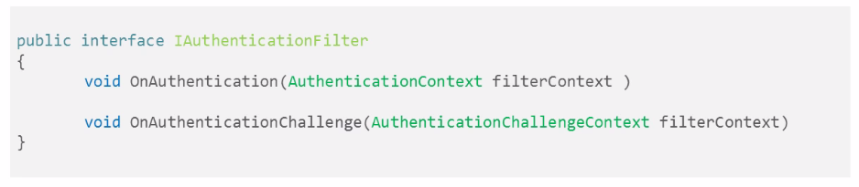
Authentication Filter
Authentication – Who someone is (introduced in MVC 5)
OnAuthentication: Used to authenticate a request and establish the identity of the user
OnAuthenticationChallenge:
Runs whenever the request failed to authenticate,
as well as right after action method execution

Slide 32
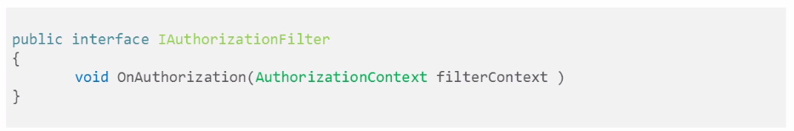
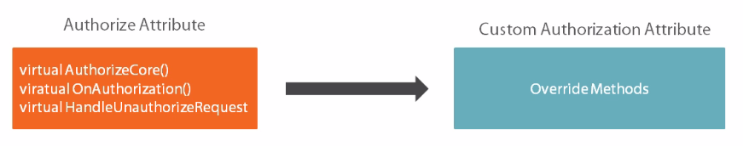
Authorization Filter
Authorization – What they should be allowed to access based on user profile information

Slide 33
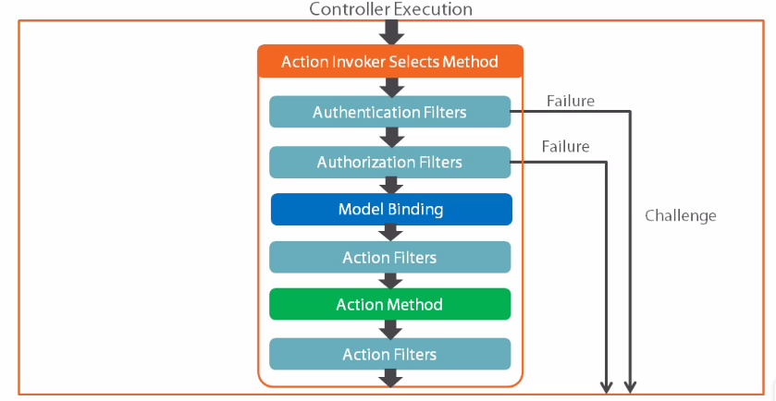
The Filter Execution Process
In case of multiple authentication and authorization filters, each group is executed in order until one of the filter returns a non-null context result.
When this happens the filter in he pipeline and other components will never be executed.

Slide 34
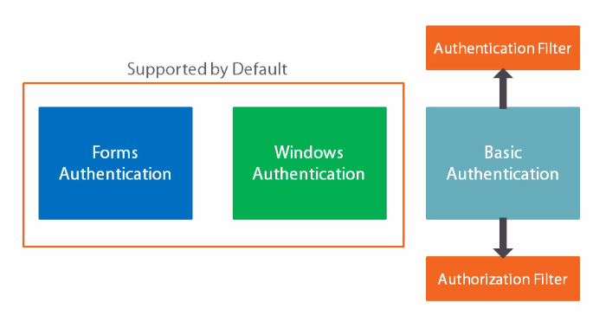
Supported Authentication Methods

Slide 35
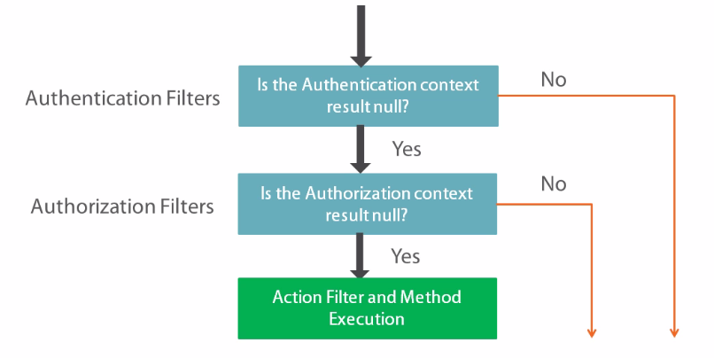
Understanding Security Filter Exception

Slide 36
Demo

Slide 37
Exception Filters
To handle unhandled exception during execution

Slide 38
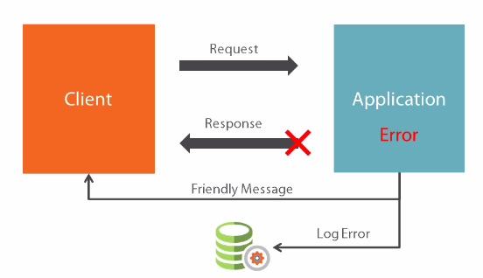
Handling and Logging Exceptions

Slide 39
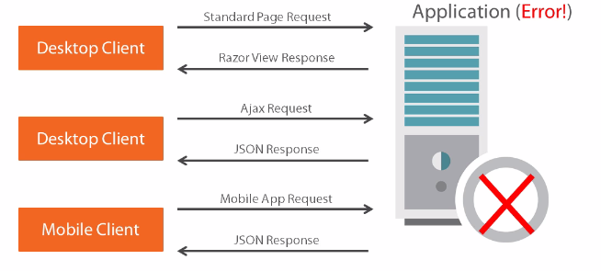
Different Requests, Different Responses

Slide 40
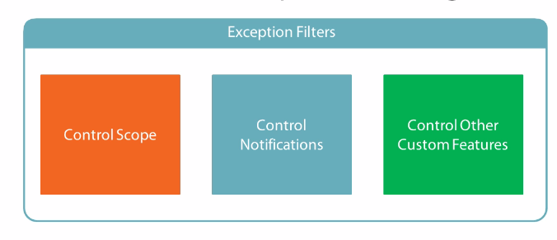
Controlled Exception Handling

Slide 41
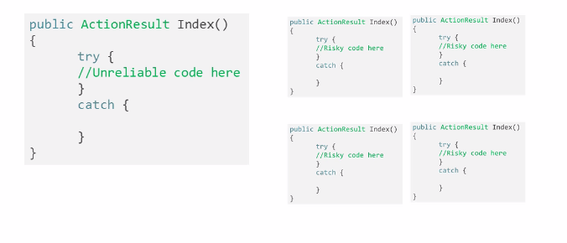
Exception Handling Strategies

Slide 42
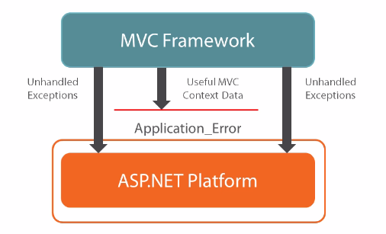
Application Level Error Handling

Slide 43
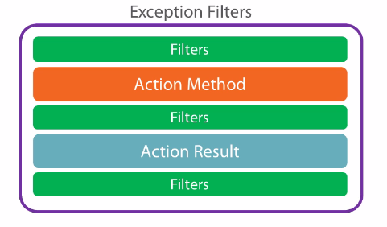
Exception Filters and MVC Life Cycle

Slide 44
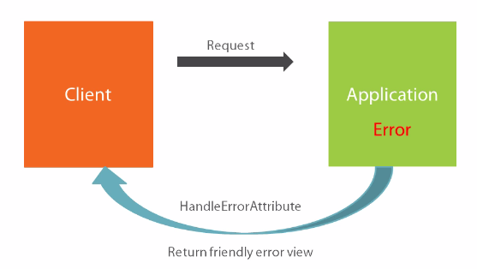
The Default Exception Filter
MVC provides a built in Exception Filter which is called Handle Error Attribute that handles errors within the scope by redirecting to a specific page
It doesn’t give lot of freedom to include custom logic

Slide 45
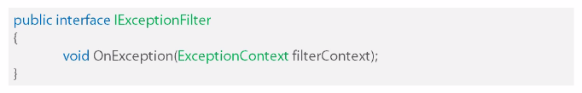
The IExceptionFilter Interface
An exception filter is a class that implements IExceptionFilter Interface and inherits from MVC’s FilterAttribute Class
Inside this onException method, you can write any custom logic on any exception

Slide 46
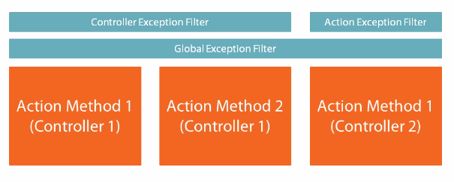
Exception Filter Exception Scope
One or more exception filters can be applied across different scope (action method, controller, application level)
If you have one controller with lot of complex logic, you can have a exception filter just for that controller

Slide 47
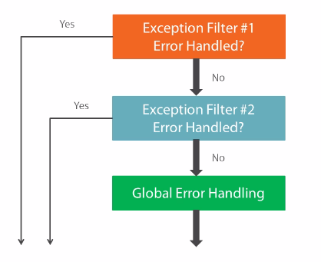
Exception Filter Execution Order

Slide 48
Demo

Slide 49
Summary
Exception Filters provide flexibility for Error Handling
Can handle errors in the scope of Action Method
Provide access to more contextual framework information
Global error handling should still be used as a fall back

Slide 50
ActionResult
Base for all action results

Slide 51
Action Result
Most action methods return an instance of a class that derives from ActionResult
ActionResult class is the base for all action results
Action Result | Helper Method | Description
ViewResult | View | Renders a view as a Web page.
PartialViewResult | PartialView | Renders a partial view, which defines a section of a view that can be rendered inside another view
JsonResult | Json | Returns a serialized JSON object.
JavaScriptResult | JavaScript | Returns a script that can be executed on the client.
FileResult | File | Returns binary output to write to the response.
ContentResult | Content | Returns a user-defined content type.
RedirectResult | Redirect | Redirects to another action method by using its URL.

Slide 52
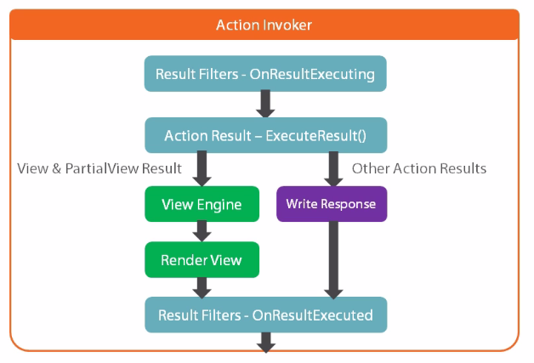
Action Result Execution Process

Slide 53
Demo
Custom action result sample

Slide 54
Result Filter
Result filters are operates on the results produced by action methods
Result filters implement the IResultFilter interface
Example: http://endyourif.com/integrating-automapper-with-an-mvc-result-filter/

Slide 55
Theme Support
To customize the look and feel

Slide 56
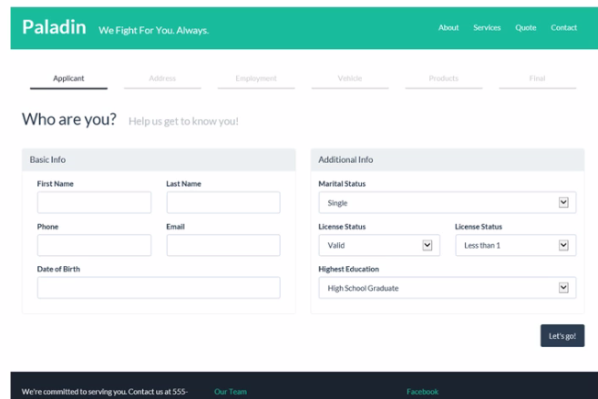
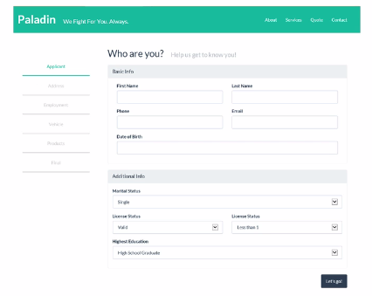
One Application Many Designs

Slide 57
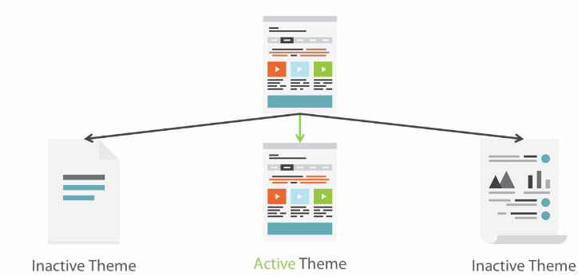
Managing Design Changes with Themes

Slide 58
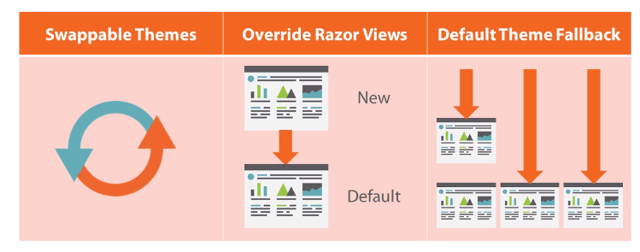
Theme Requirements

Slide 59
Theme Support with Custom View Engine
Use a custom View Engine to extend view selection functionality
Themes provide a dynamic way to manage different design templates
You can change where and how Razor selects a template file by modifying the View Engine’s Search locations
MVC supports multiple View Engines

Slide 60
View Engines
Component of MVC which is responsible for locating and rendering views
You can extend and View Engine or you can write your own view engine from scratch
Extending a view engine is very simple with minimal code
View Engine in MVC are implemented using IViewEngine Interface
This interface have few methods for locating and releasing the view request
For enabling theme support we need to customize the Razor’s default location logic

Slide 61
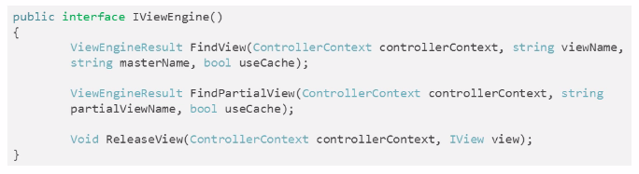
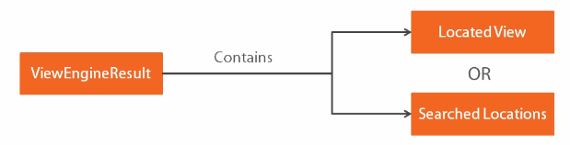
IViewEngine Interface

Slide 62
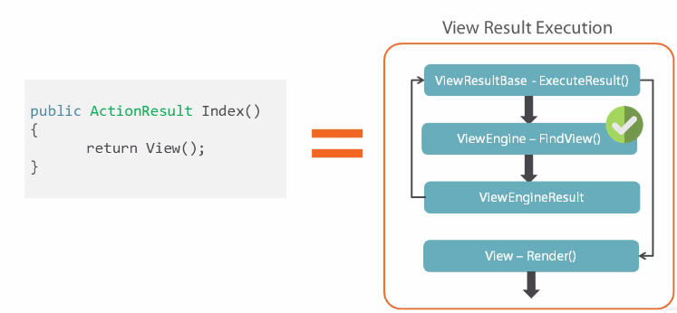
ViewResult Execution Process

Slide 63
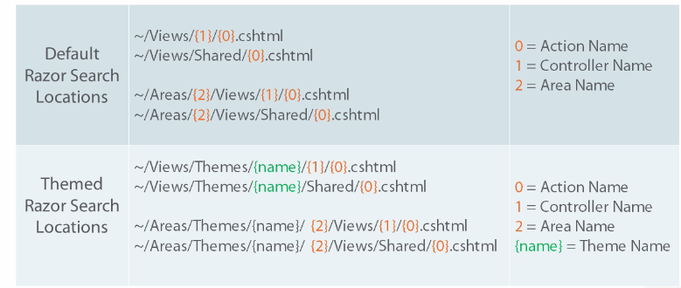
Locating views with Razor Engine

Slide 64
Demo

Slide 65
Best Practices
Implementing best practice is copying yesterday

Slide 66
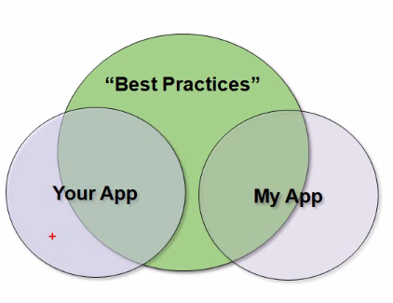
Overview
Views
Controllers
Security
General Tips

Slide 67
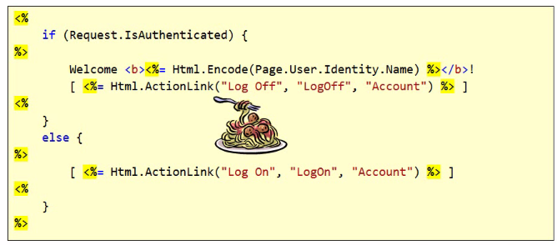
View Code
Avoid spaghetti Code
Use partial views to reduce complexity
Use HTML helpers to encapsulate logic (this is preferred particularly when branching is involved)

Slide 68
Use Strongly Typed Views
Always use strongly typed views instead of dynamic
Easier to author with Intellisense
Easier to refactor and find errors
Build your views to track down problems
Set MVCBuildViews to true
<MvcBuildViews>true</MvcBuildViews>
Demo

Slide 69
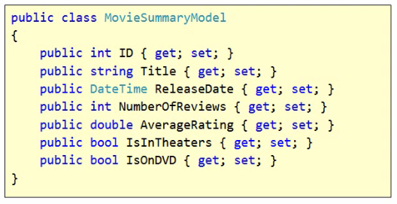
View Models
A view model is dedicated to one or more views
Takes pressure off your business objects and entities
Easier to perform calculated values outside of view
Easy to unit test

Slide 70
JavaScript
Remove all signs of JavaScript from a View
Advantages
View is strictly presentation
Allows you to focus on script code
Disadvantages
Additional file(s) to download - Can combine scripts

Slide 71
Security: XSS (Cross Site Scripting)
MVC, by default, prevents any requests containing HTML markup, in order to avoid XSS attacks.
Prevent cross-site scripting attacks
Be very, very, careful turning off input validation
Microsoft Anti-Cross Site Scripting Library (http://tinyurl.com/cpu7g4)
Demo

Slide 72
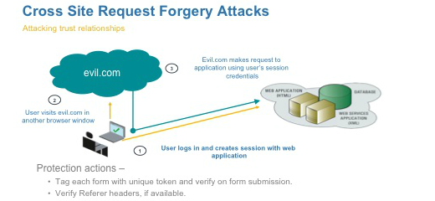
Security: CSRF

Slide 73
CSRF Attack
A user logs into www.example.com, using forms authentication
The server authenticates the user. The response from the server includes an authentication cookie.
Without logging out, the user visits a malicious web site. This malicious site contains the following HTML form:
<h1>You Are a Winner!</h1>
<form action="http://example.com/api/account" method="post">
<input type="hidden" name="Transaction" value="withdraw" />
<input type="hidden" name="Amount" value="1000000" />
<input type="submit" value="Click Me"/>
</form>
The user clicks the submit button. The browser includes the authentication cookie with the request
The request runs on the server with the user’s authentication context, and can do anything that an authenticated user is allowed to do.

Slide 74
CSRF Attack
The malicious page could just as easily run a script that sends an AJAX request
Using SSL does not prevent a CSRF attack, because the malicious site can send an “https://” request
CSRF attacks are possible against web sites that use cookies for authentication, because browsers send all relevant cookies to the destination web site

Slide 75
Anti-Forgery Tokens
To help prevent CSRF attacks, ASP.NET MVC uses anti-forgery tokens, also called request verification tokens
The client requests an HTML page that contains a form.
The server includes two tokens in the response. One token is sent as a cookie. The other is placed in a hidden form field. The tokens are generated randomly so that an adversary cannot guess the values.
When the client submits the form, it must send both tokens back to the server. (Browser client automatically does this when the user submits the form)
If a request does not include both tokens, the server disallows the request.
Anti-forgery tokens work because the malicious page cannot read the user’s tokens, due to same-origin policies.

Slide 76
Anti-Forgery Tokens in MVC
To add the anti-forgery tokens to a Razor page, use the HtmlHelper.AntiForgeryToken helper method:
@using (Html.BeginForm("Manage", "Account"))
{
@Html.AntiForgeryToken()
}
This method adds the hidden form field and also sets the cookie token

Slide 77
Anti-CSRF with AJAX
For AJAX requests we need to send the tokens in a custom HTTP header.
The tokens are generated at the server by calling AntiForgery.GetTokens.
<script>
@functions{
public string TokenHeaderValue()
{
string cookieToken, formToken;
AntiForgery.GetTokens(null, out cookieToken, out formToken);
return cookieToken + ":" + formToken;
}
}
$.ajax("api/values", { type: "post", contentType: "application/json", data: { }, // JSON data goes here dataType: "json", headers: { 'RequestVerificationToken': '@TokenHeaderValue()' } });
</script>

Slide 78
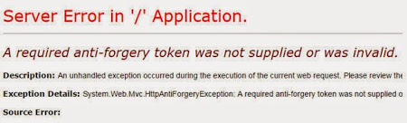
Anti-CSRF and AJAX Cont…
When you process the request, extract the tokens from the request header
Then call the AntiForgery.Validate method to validate the tokens.
The Validate method throws an exception if the tokens are not valid.
void ValidateRequestHeader(HttpRequestMessage request)
{
string cookieToken = ""; string formToken = "";
IEnumerable<string> tokenHeaders;
if (request.Headers.TryGetValues("RequestVerificationToken", out tokenHeaders))
{
string[] tokens = tokenHeaders.First().Split(':');
if (tokens.Length == 2)
{
cookieToken = tokens[0].Trim();
formToken = tokens[1].Trim();
}
}
AntiForgery.Validate(cookieToken, formToken);
}

Slide 79
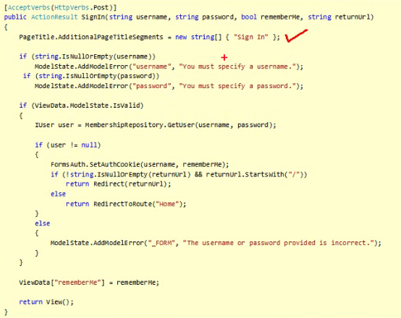
Controllers
Keep Controllers Focused
Controllers action methods must be 4 to 10 lines of code, and delegate to other components as much as possible
See how many test cases that you need to write for this method?

Slide 80
Compression & Caching
Compression is used to compress the response from MVC Application
Caching
Caching plays a major role in developing highly scalable web applications.
We can cache any http get request in the user browser for a predefined time, if the user request the same URL in that predefined time the response will be loaded from the browser cache instead of the server.
Demo

Slide 81
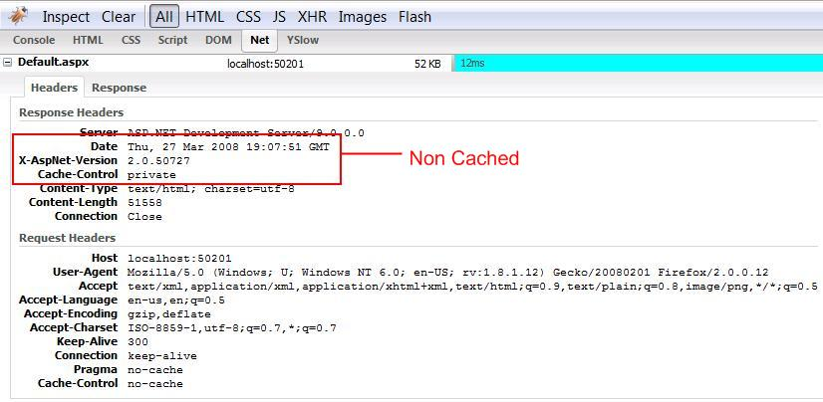
Caching

Slide 82
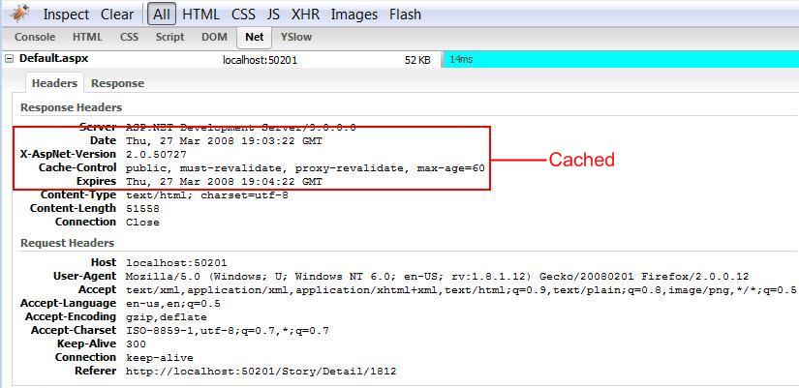
Caching

Slide 83
Use the below link if you want to check the MVC code.
https://aspnetwebstack.codeplex.com/sourcecontrol/latest#src/System.Web.Mvc/RazorViewEngine.cs

Slide 84
Thank You

